Slide 1


Specialized Parking Oriented Technology (S.P.O.T.) Senior Design Project June 15, 2018
Team Members:
Ramsey Ghanaim
Jonathan Lam
Mario Cabrera
Travis Rogers

Slide 2
Motivation
UCSC has an inefficient parking system
Never know when parking lots are full
Takes time to travel between parking lots to check availability
R permits will no longer be valid at North Remote Lot by September 1
We want to modernize the parking system both for users and parking administration

Slide 3
Problem Statement
Our objective is to improve upon the current UCSC parking system by including:
An easier way to find parking via mobile app
An automated way to verify/pay for parking with or without permits
An administrator tracking system
Real-time parking status updates
Our goals for SPOT is to create a modern Parking Management System that is:
Low powered for each parking unit
Intuitive and convenient for users
Functional for parking administrators

Slide 4
Project Requirements
Hardware
SoftwarE
Spot unit
Proximity sensor, Bluetooth, and LEDs to communicate with users
Wifi interface to connect with gateway and system
Efficient
Easy to use for users
Scalable
Low power
Scalable
Allow software to be used in a variety of different parking sizes
Easy to Use
Intuitive user experience for mobile app
Users can monitor parking lot statuses
Simple administrative website
4

Slide 5
Our Approach
What technologies do we use?
Google Cloud Platform’s App Engine
Scalable Server
SPOT Sensor
A low cost, low power sensor to detect and report a spot status
Gateway
Middle-man between Sensors and App Engine
Mobile App
Check parking lot usage
Verify your permit when parking
Administrator Website
Admins can manage parking lots and user accounts
5

Slide 6
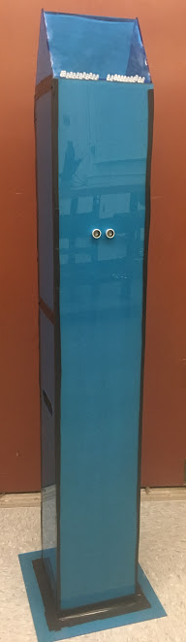
S.P.O.T. Sensor
Power management
Body design
Ultrasonic sensor to detect car
LEDs to communicate with user
Bluetooth to connect to user's app
Wifi to connect to gateway

Slide 7
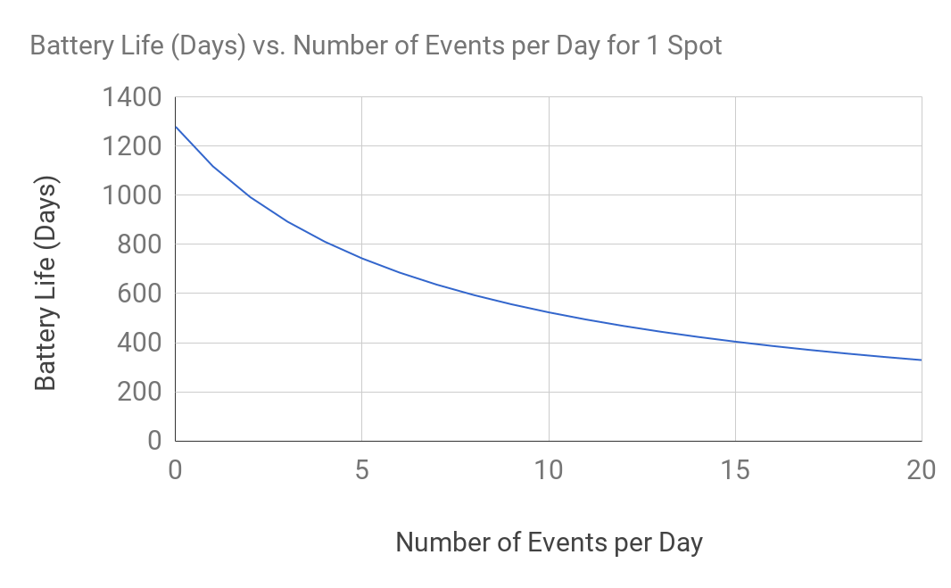
Power Consumption
Assumptions:
13 hour workday
Microcontroller on for 1 second, followed by 3 seconds of sleep
20 second average user verification where the MC/Bluetooth Beacon must be on
Unit draws between 2 to 10 mAh per day depending on activity
3,000 mAh battery (3 AA batteries in series)
One year battery life on an average day (10 events per day)

Slide 8
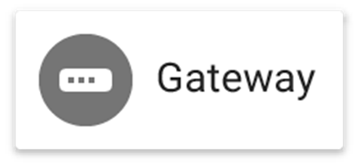
Gateway Implementation
Purpose:
Combine traffic to send in one connection to the App Engine to allow this project to scale.
Forward status's from SPOT sensor to the App Engine
Forward LED statuses from App Engine to SPOT sensors
Reliability
Make messages re-send if not sent properly
Have Sensors consistently “check in” with the Gateway to keep track of working SPOT sensors

Slide 9
Google App Engine - Web Application
Connectivity between system components
Purpose:
Manages status changes for spots
Updates SQL database
Verifies users through the mobile app
Payments
Permit Enforcement
Tracks transaction and spot occupation history

Slide 10
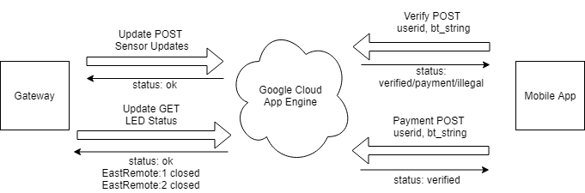
Google App Engine - Implementation
Information sent through HTTP GET/POST messages
Data encoded in JSON objects
Gateway, Mobile App, Website
App Engine forwards messages to custom HTTP handlers
Hosts admin website and provides functionality
Verify POST
User Info
Update POST
Sensor Updates
Update GET
LED Status
Payment POST
User Info

Slide 11
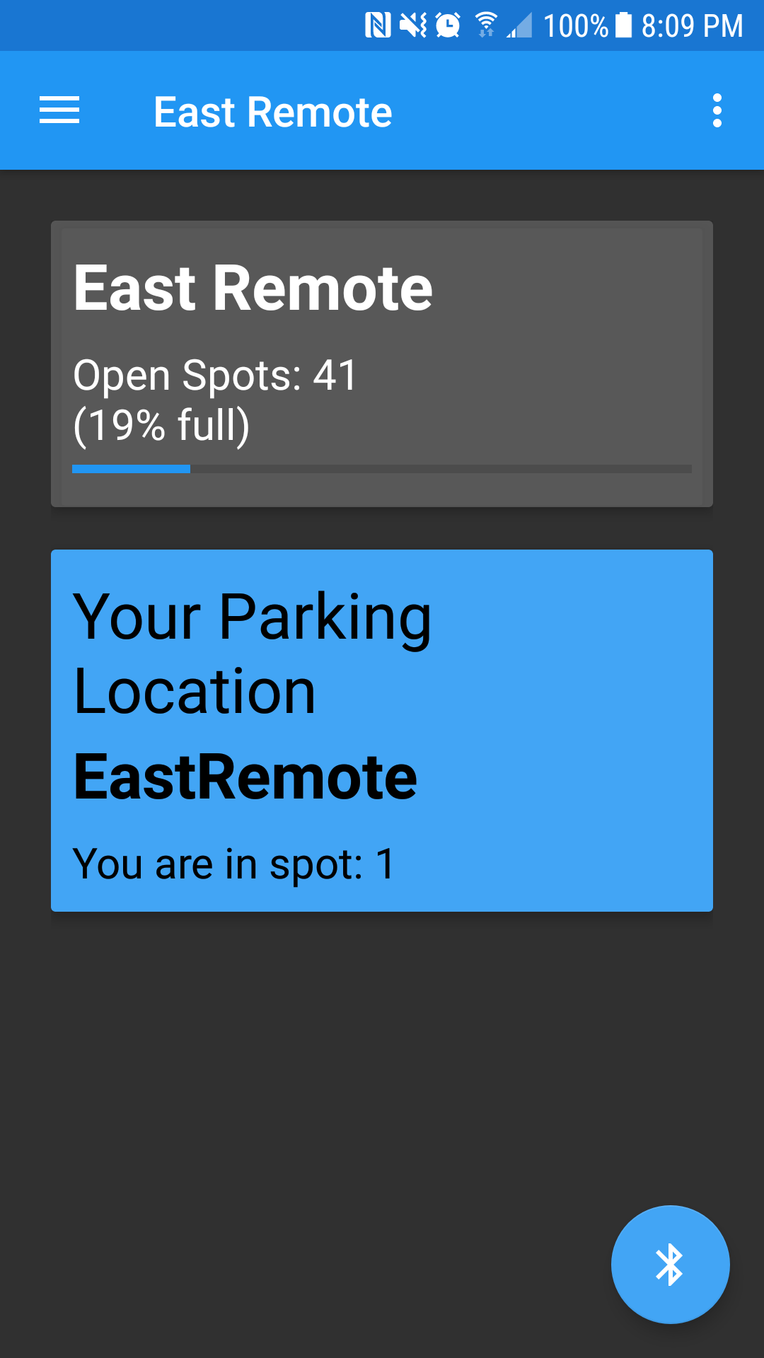
Mobile App - Overview
Purpose:
Check number of available parking spaces per lot
Verify your parking permits and parking payments
Bluetooth Scanner:
App communicates with the SPOT unit using Bluetooth
Confirms parking status and parking location
Navigation
Drawer
Log Out
Scan for
Beacons

Slide 12
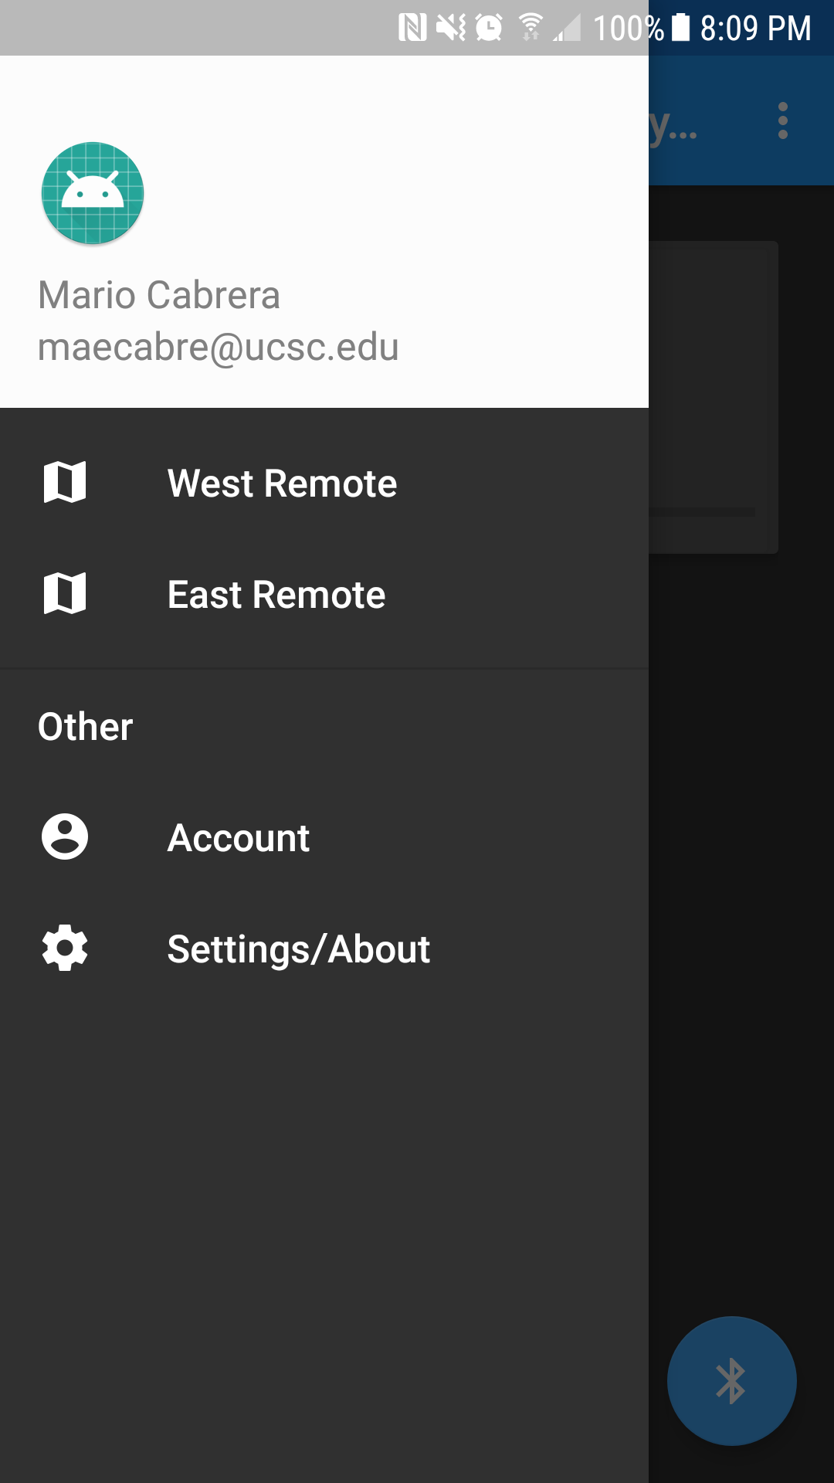
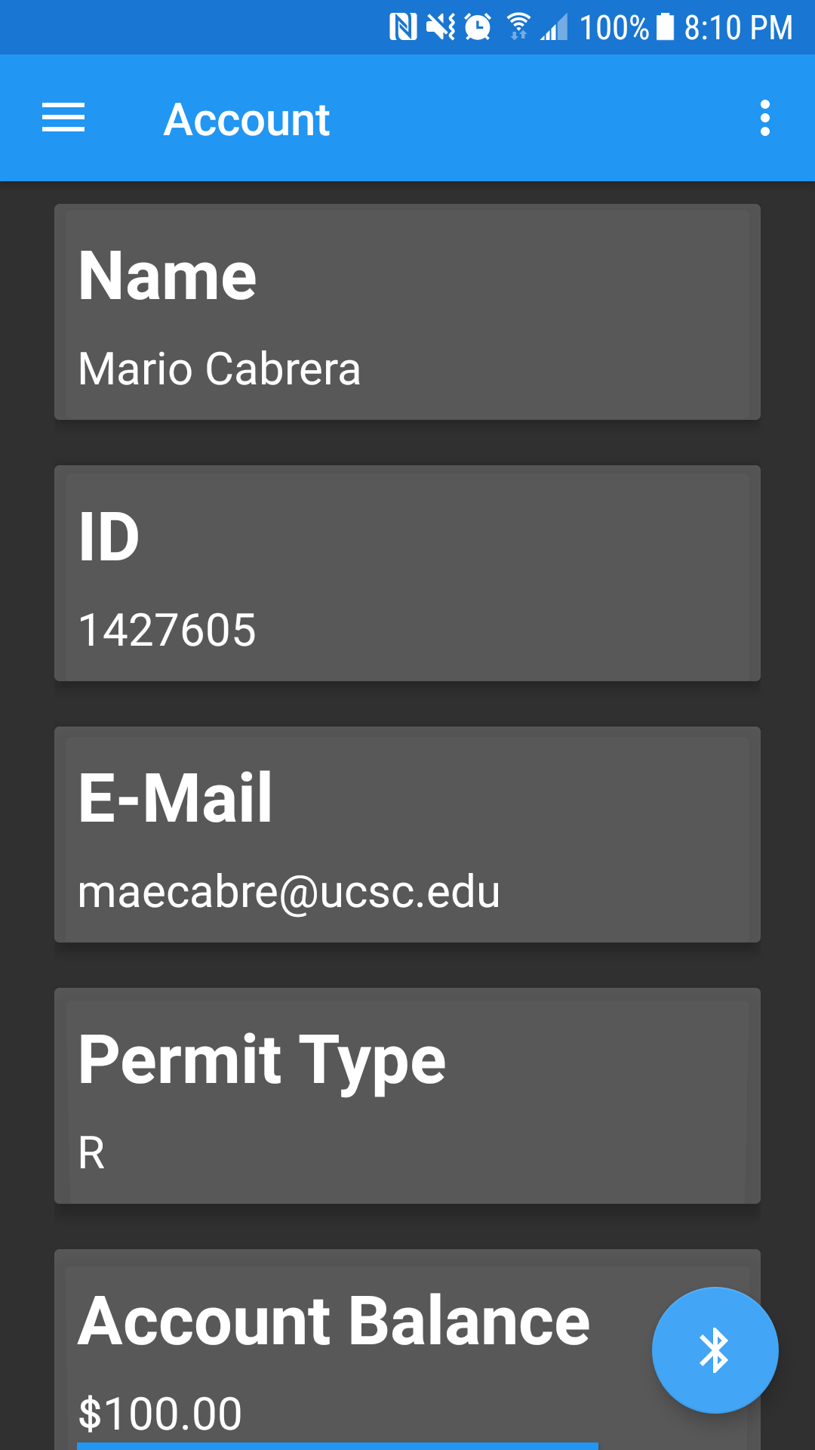
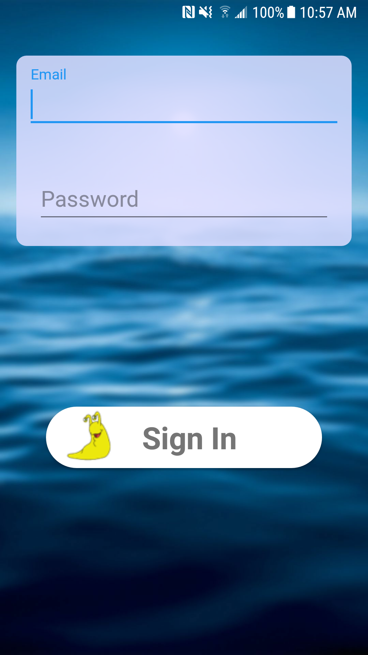
Mobile App - User Interface and Layout
Navigation Drawer
Account Page
Login Page

Slide 13



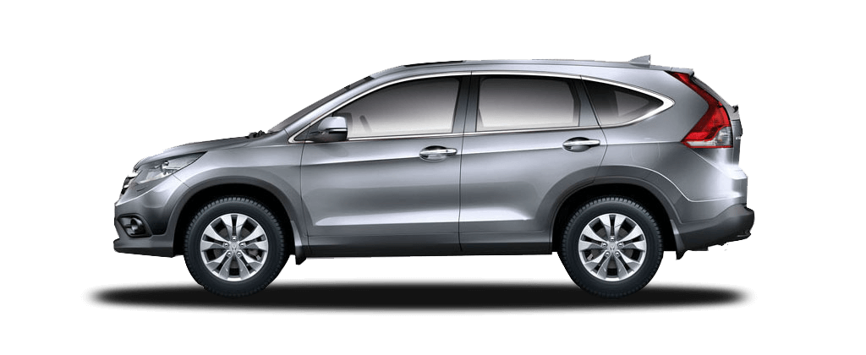
Mobile App - Parking Process
Source: honda.com

Slide 14
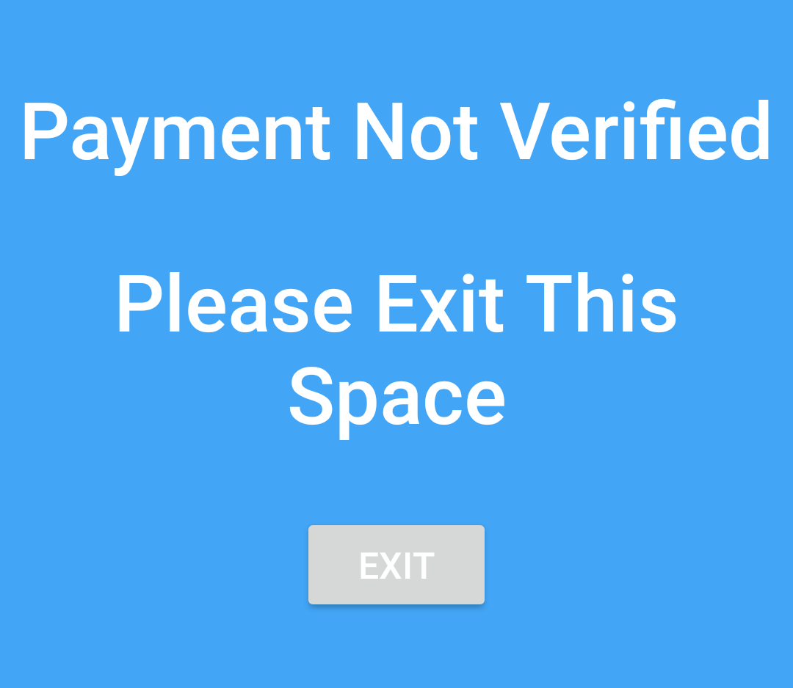
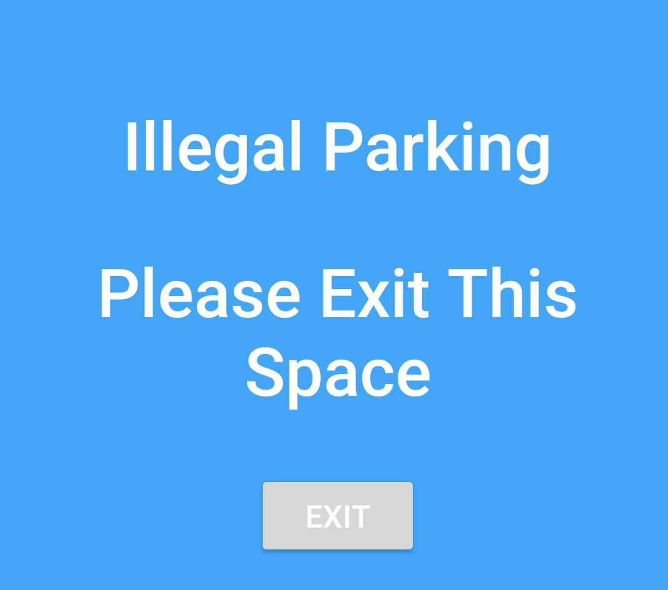

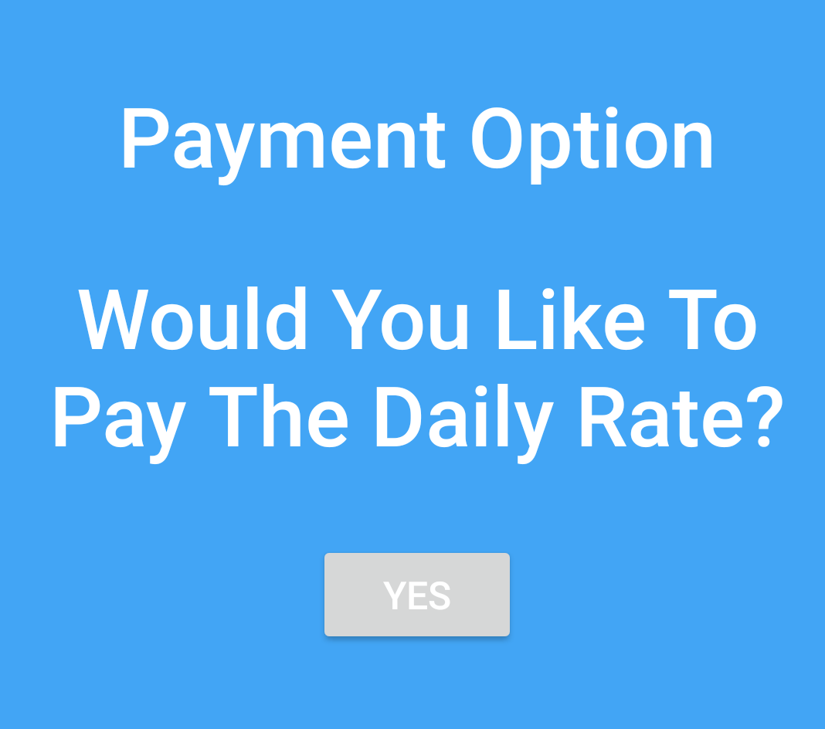
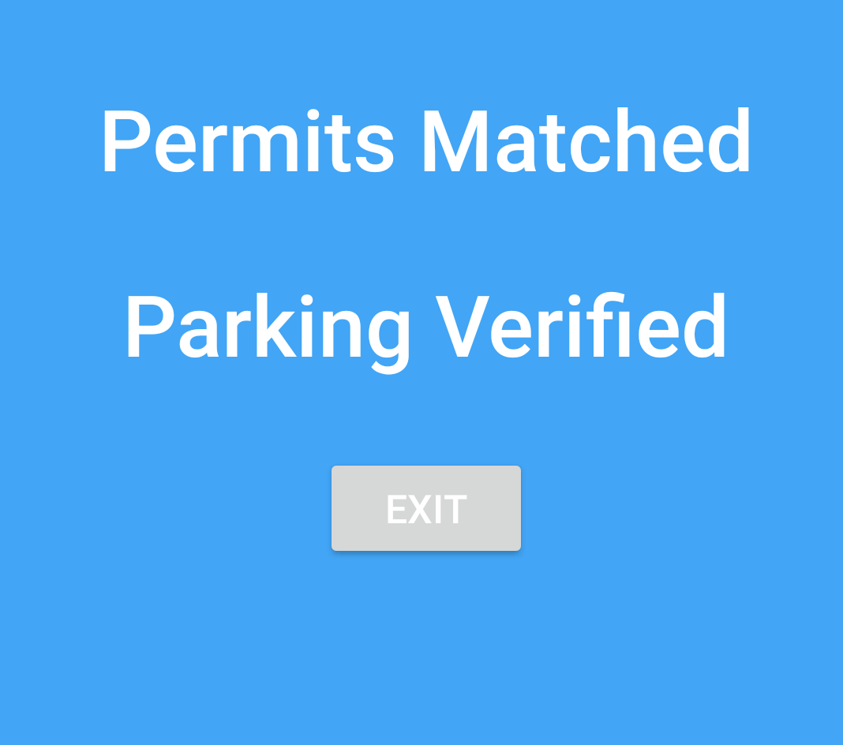
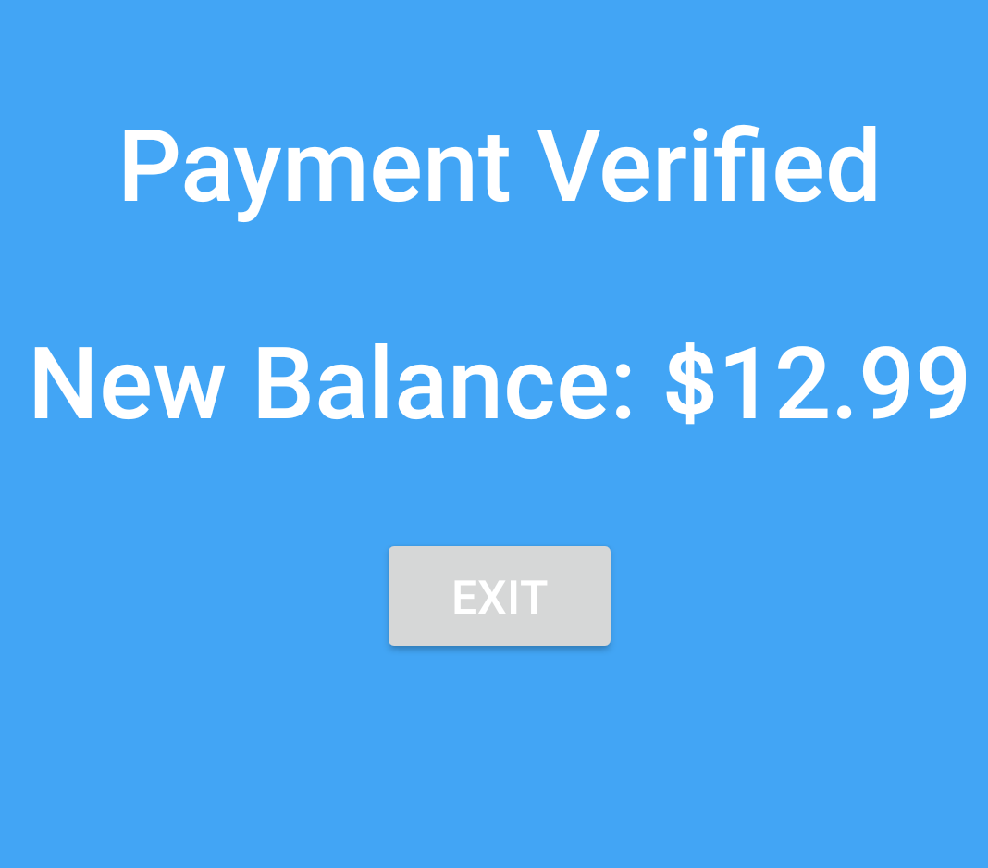
Mobile App - Permit/Payment Process

Slide 15
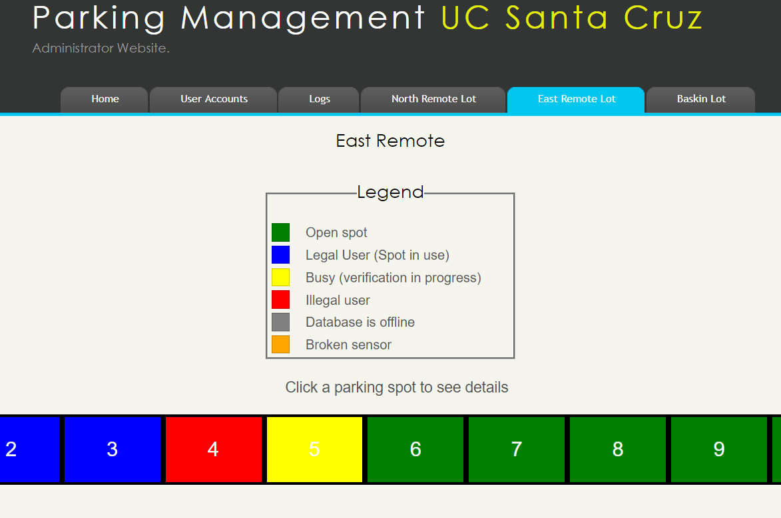
Administrator Website
Live view of Parking Spaces
Clicking on a space shows more details (User credentials)

Slide 16
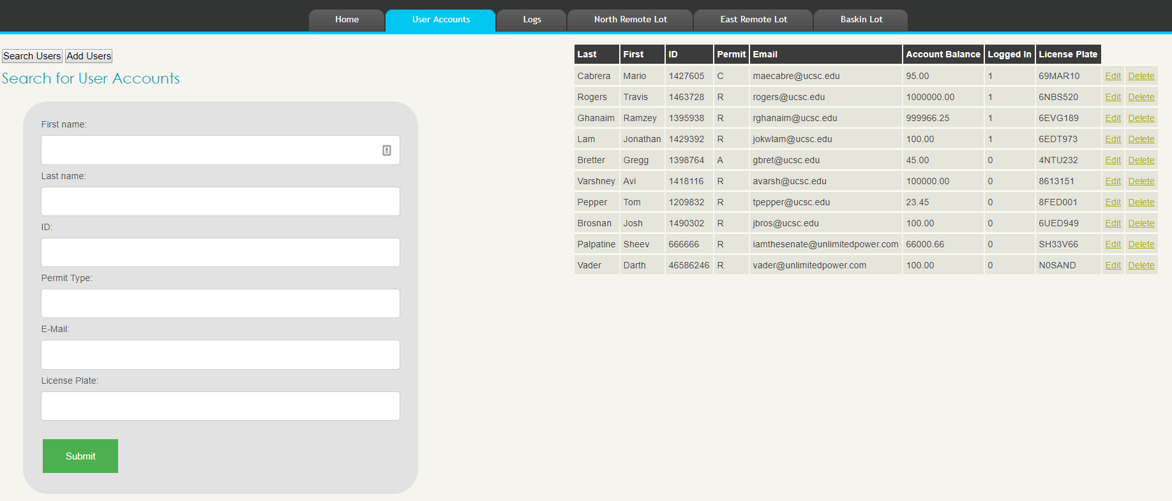
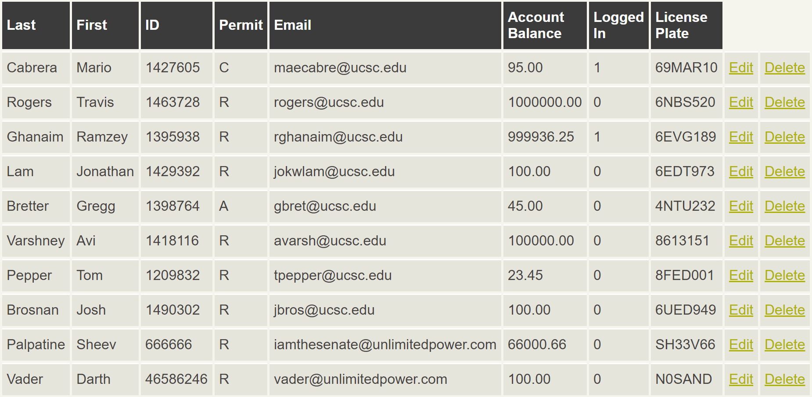
Administrator Website
Edit account Information and add new accounts

Slide 17
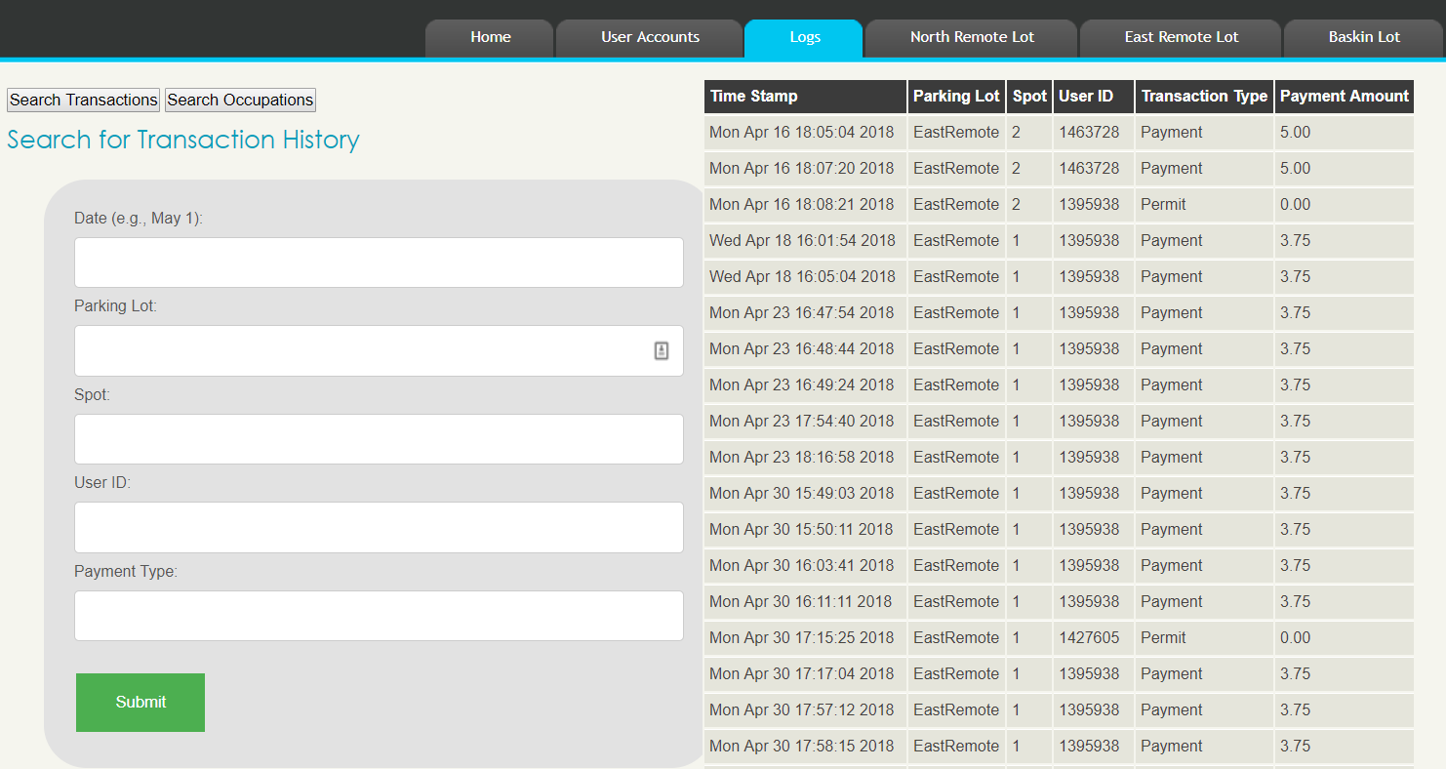
Administrator Website
View transaction and occupation history

Slide 18
Results
SPOT accomplishments
Long lasting sensors units to verify parking spots
Easy to use mobile app for spot verification
Admin website for parking administration
Cloud infrastructure for scalability
What could be improved on?
Implement solar panels to further increase battery life
Camera for license plate recognition
Analytics

Slide 19
Thank You

